Slide 1
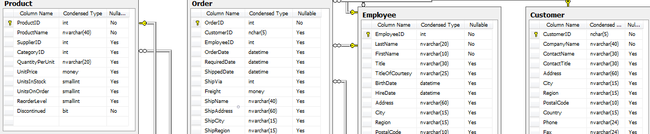

Northwind DB Hypothesis Testing

Slide 2

Hi there! I’m a software engineer based in NY and working for the UN, and an aspiring data scientist at Flatiron Academy
Barto Molina, Flatiron DS, April 2019 cohort

Slide 3
the company
77 products from 29 suppliers
8 categories
830 orders shipped by 3 shipping companies
9 employees covering 53 territories in 4 regions
91 customers from all over the world

Slide 4
project scope
discount product quantity
Does discount amount have a statistically significant effect on the quantity of a product in an order? If so, at what level(s) of discount?
customer region order price
Does the customer region have a statistically significant effect on the total price of an order?
employee order price
Does the employee have a statistically significant effect on the total price of an order?

Slide 5
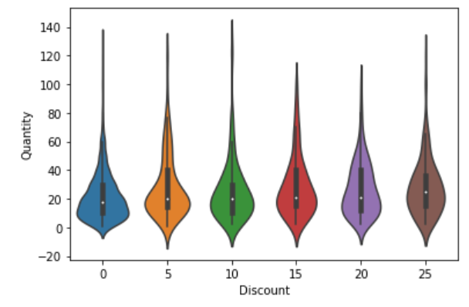
discount
product quantity
Main discount levels
0%, 5%, 10%, 15%, 20%, 25%
Group orders by Order / Product
15% highest effect on the product quantity
Welch’t T-test: 5.02 e-11
Effect Size: 0.3 (15% - 0.37)
Discount

Slide 6
customer region
order price
Customers from 9 different regions
Total price of the order by customer region
Group orders by Customer / Order
region

Slide 7
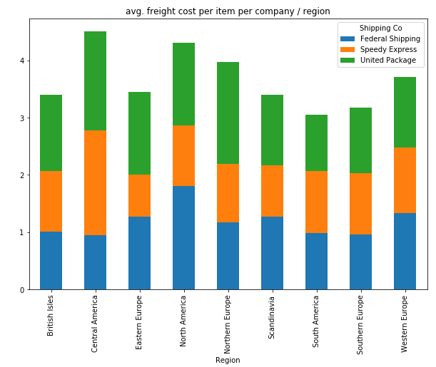
customer region
order price
Does freight make a difference?
region
We can’t conclude that the freight cost has an influence on the order price

Slide 8
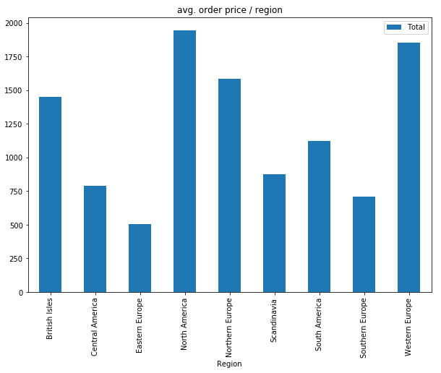
customer region
order price
Price by region
region
The region has an impact on the total price of the order

Slide 9
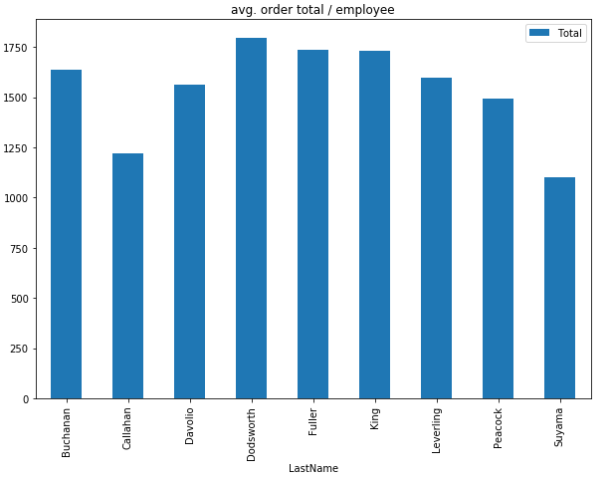
employee
order price
9 employees
Total price of the order by employee
employee
The region has an impact on the total price of the order

Slide 10
final recommendations
waterfront – 75% up
top 4 zipcodes – 50% up
grade instead of condition – up to a 180%
living area instead of total square footage

Slide 11
thank you.

